Slide 1
API JOURNEY

Slide 2
What is an API?
ClarionLive300 – What is an API?
ClarionLive302 – REST, Get & Post
ClarionLive304 – JSON using jFiles
ClarionLive459 – Consuming APIs
ClarionLive461 – OAuth

Slide 3
Clarionlive Webinars
ClarionLive454 – Chilkat Wrapper Template
More geared towards using it from a Windows app
oAuth login screen opens on server not on user’s PC
ClarionLive286 – oAuth1 and connecting to QuickBooks
oAuth1 and xFiles
QuickBooks Online is using oAuth2 now
ClarionLive463 – Python
Learning curve
oAuth login screen opens on server not on user’s PC

Slide 4
Journey
First looked at Chilkat templates
Then had a look at Python
Problem with both, for me, was that they open the user login screen on the server and not the user’s PC as my app is a NetTalk app
Using Debra’s oAuth1 QuickBooks sample app from Webinar286

Slide 5
QuickBooks with oAuth1
Problem is all new QuickBooks Online apps must use oAuth2
Webinar461 - NetTalk supports oAuth2
Changed the oAuth1 to oAuth2 in Debra’s QB App
Had some oAuth challenges and Bruce made some changes to NetTalk
NetTalk doesn’t like http://localhost, had to use local certificates so I can use https://localhost
QB Online Mind Map – Look at Connect

Slide 6
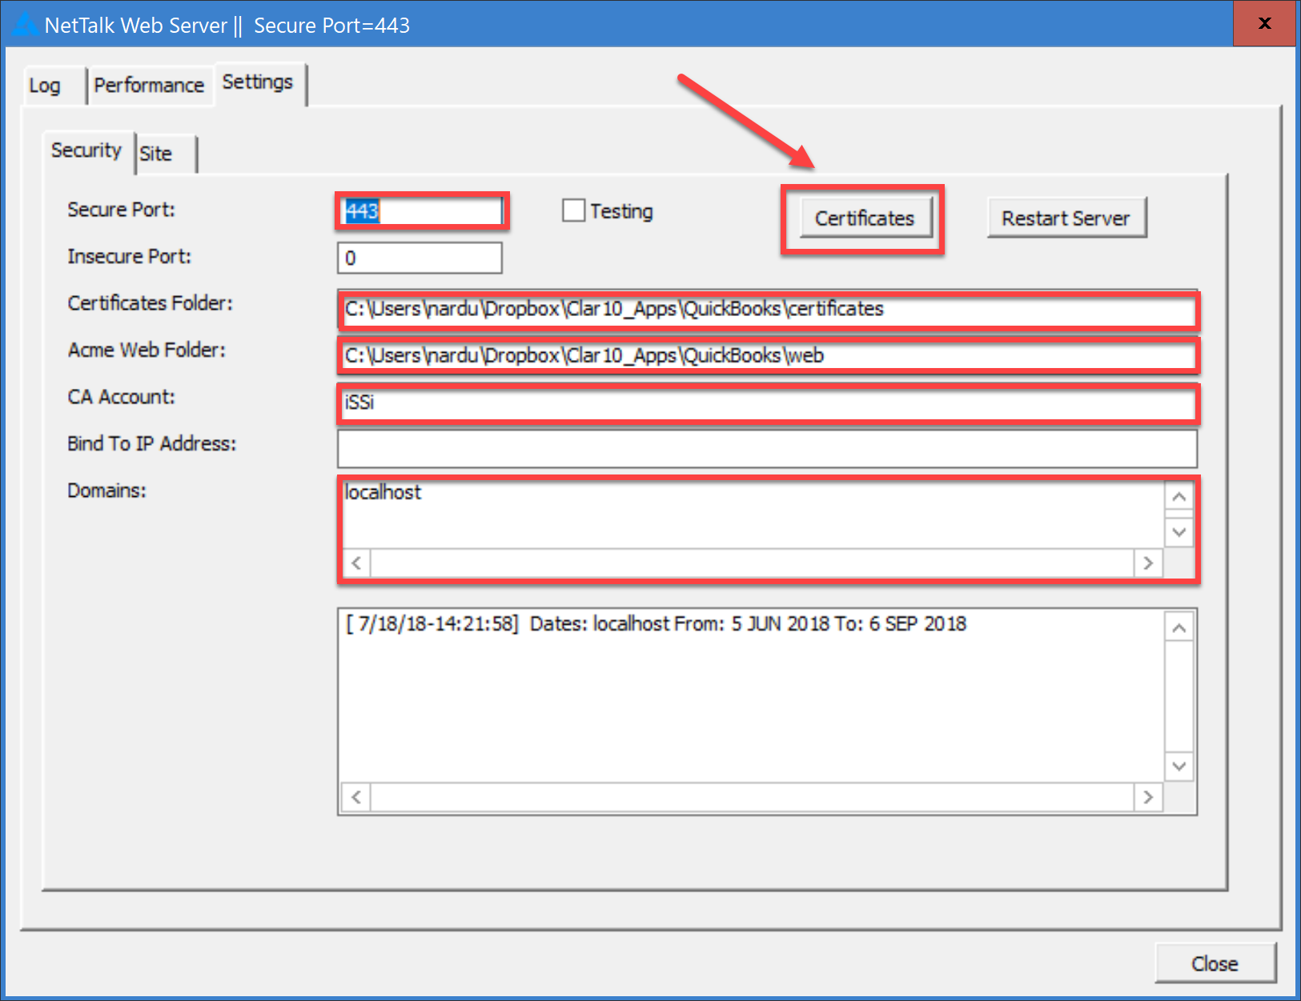
Local Certification

Slide 7
Quickbooks with oAuth2
Next step was to do a Get against QuickBooks
QB Online Mind Map – Tools & API Process
Could not get the Get to work
And this is where the real journey started

Slide 8
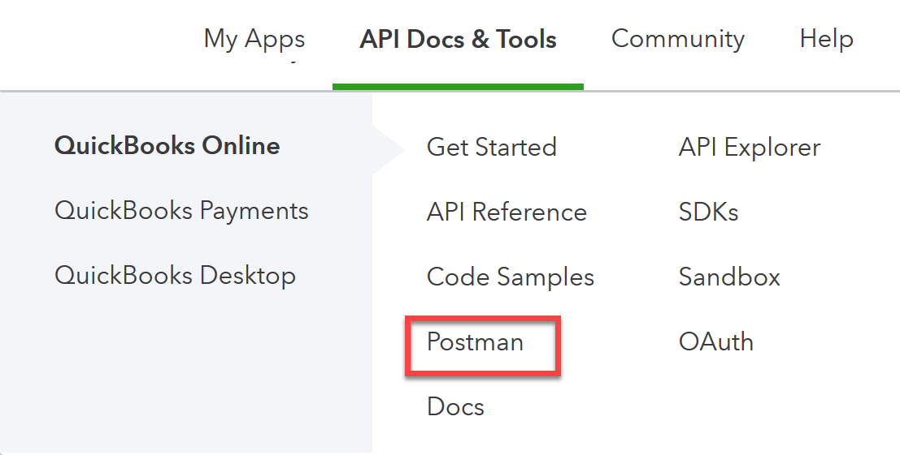
Getting get to work
Was getting an error on executing the Get
I used Postman before during SAP course
Also found Postman reference on QuickBooks site
I used Postman before I knew about the QuickBooks API Explorer

Slide 9
POSTMAN
Postman Mind Map
Demo

Slide 10
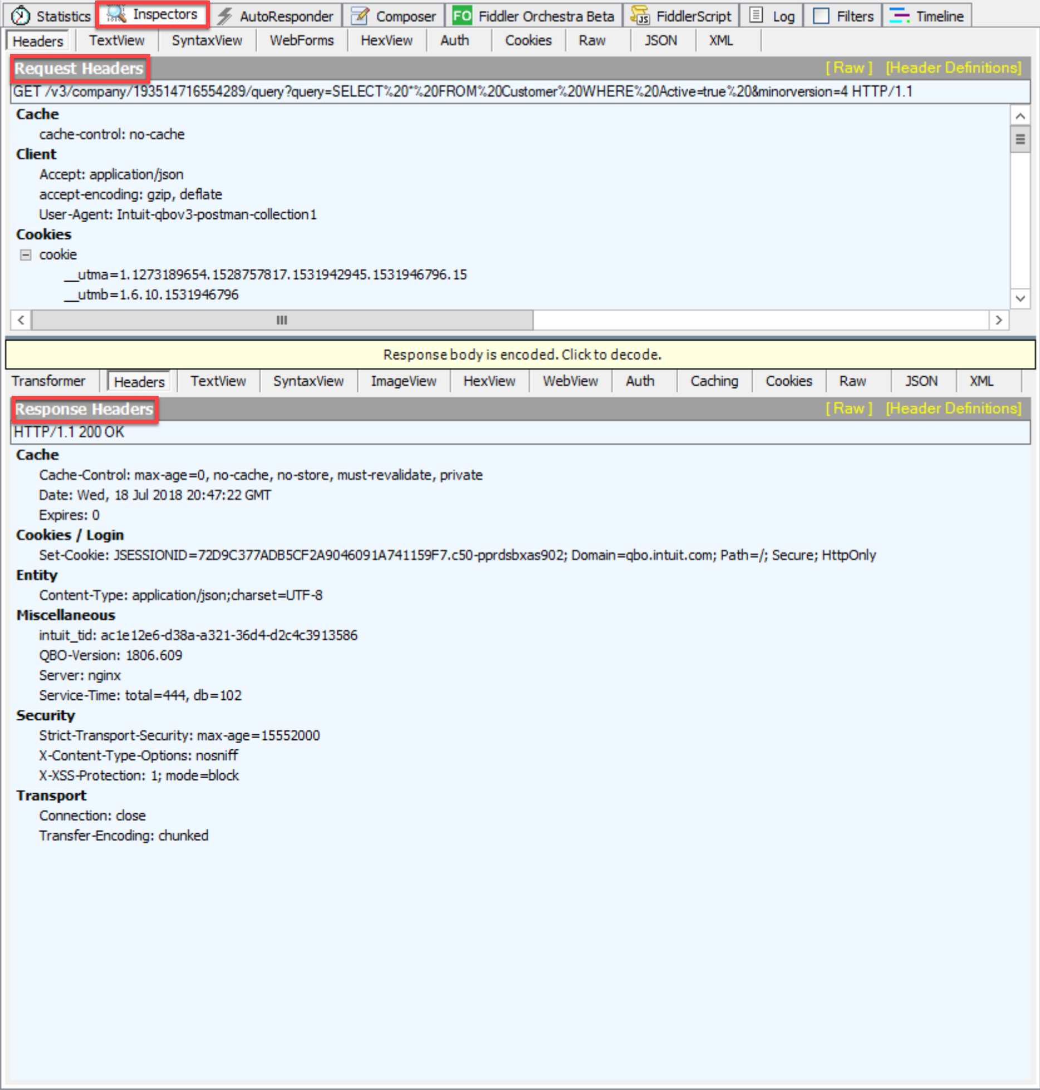
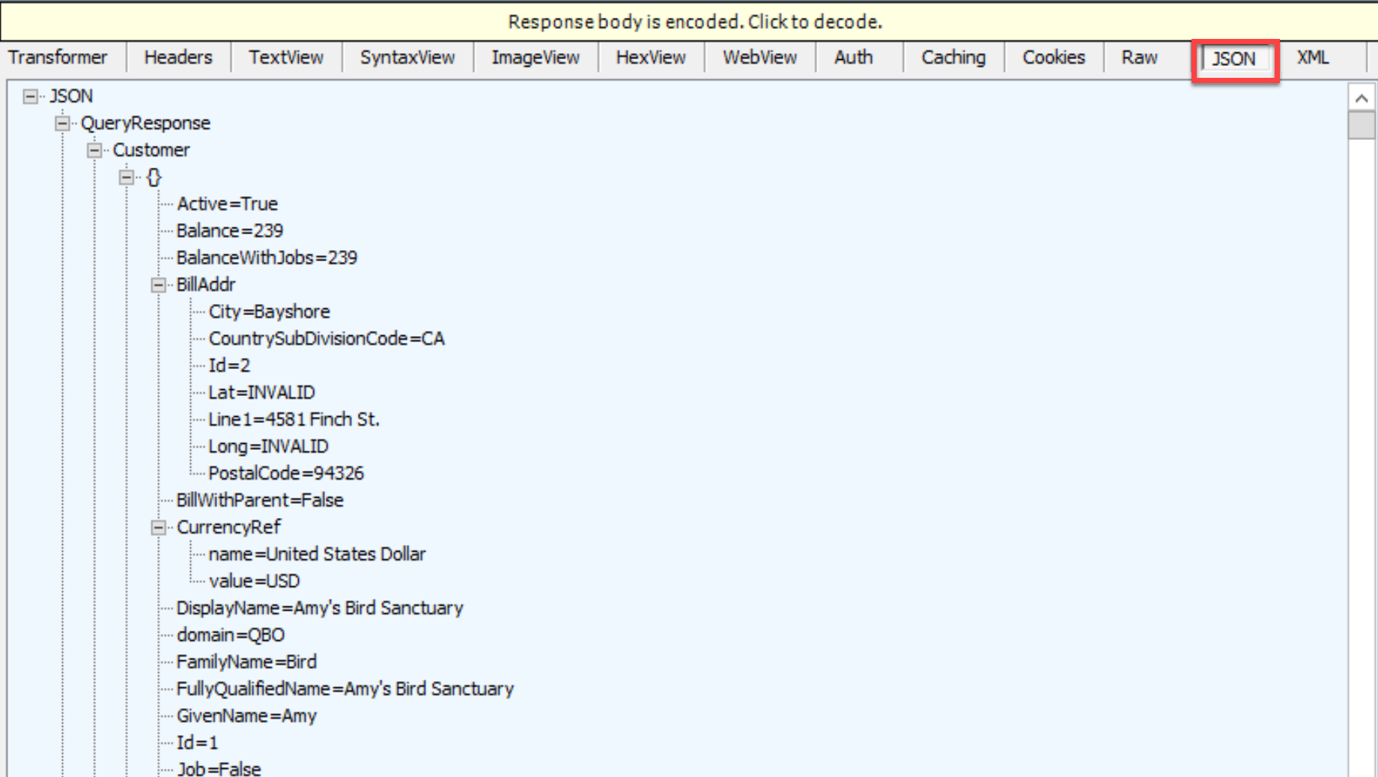
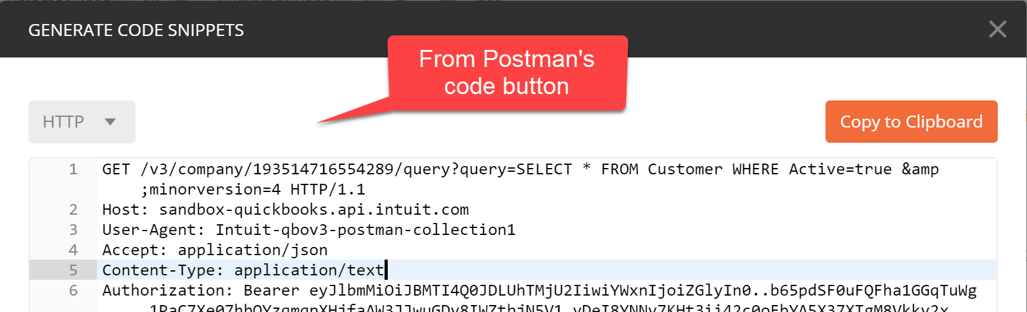
Getting get to work
Back to the journey
The Get works in Postman but not in my app
Ran Fiddler to see what is send to QuickBooks from Postman

Slide 11
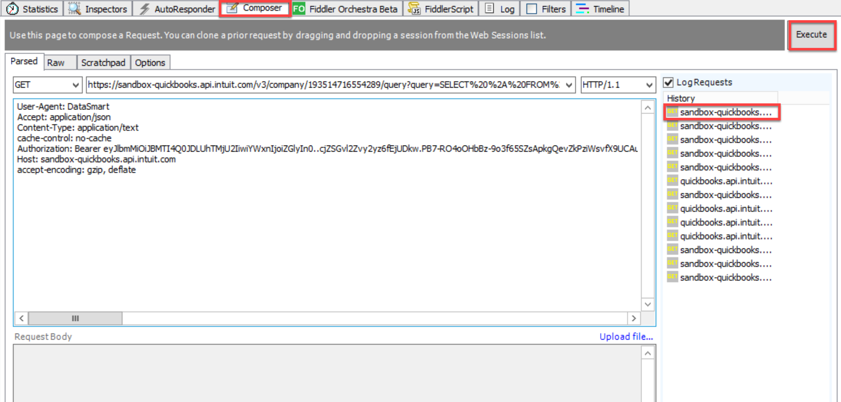
Getting get to work
Resubmit in Fiddler to make sure it works

Slide 12
Getting Get to work
Now that the Get is working in Postman…
Should be easy to take that to my NetTalk app and get it to work.
Still not working!!!!
In the end my problem was that I did not encode the query string
SELECT * FROM Customer WHERE Active=true
What the code looks like in Postman
SELECT+%2A+FROM+Customer+WHERE+Active%3Dtrue
What the code looks like in Fiddler or if you paste it into the url encode/decode website
In hind sight a obvious problem but not until I knew what the problem was.

Slide 13
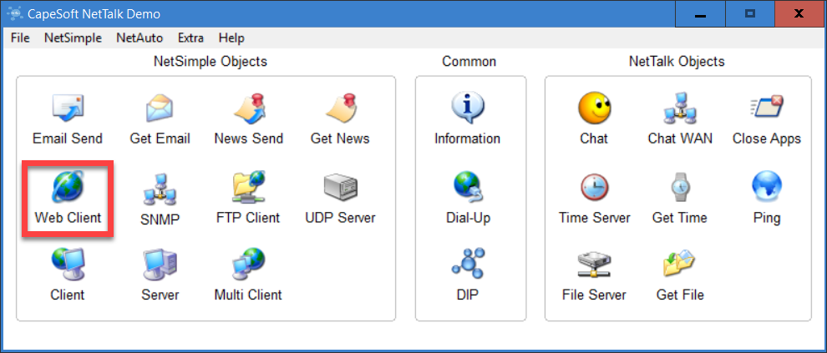
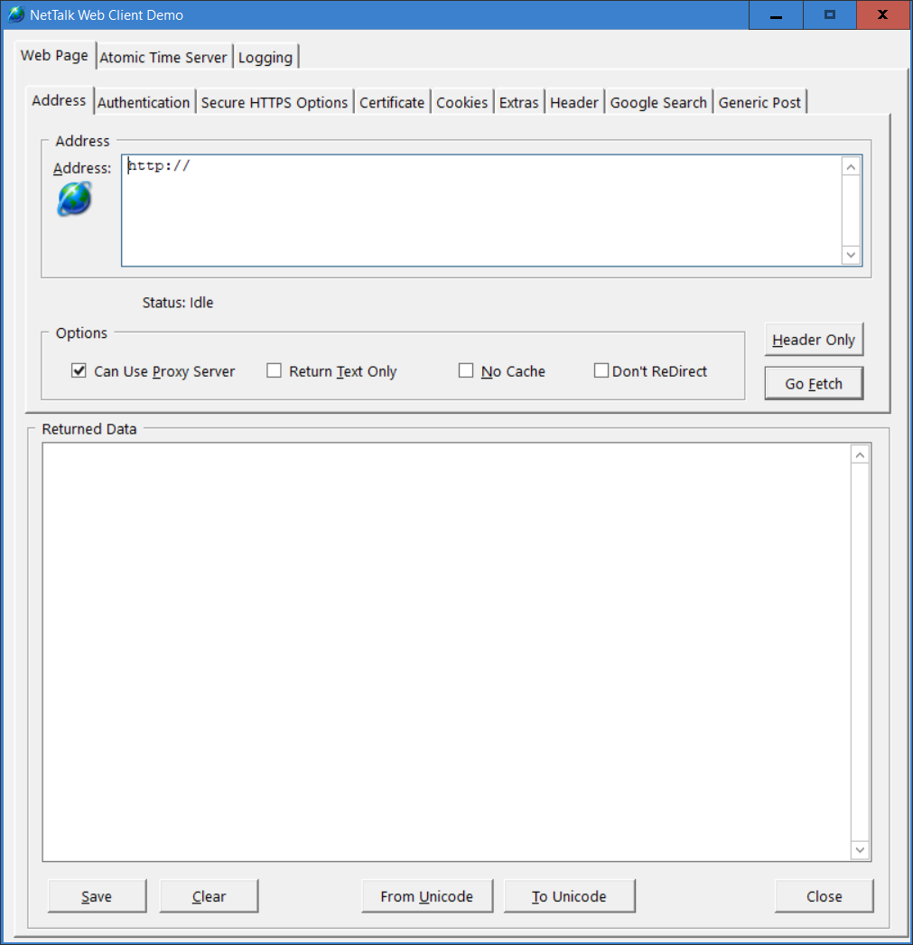
Getting the get to work
Encoded the URL in my NetTalk app
But still getting an error in my NetTalk App
Remember Bruce always says: test in the demo app and see if it works there
Added trace statements, copy output from DebugView++ into NotePad++
Open NetTalk Demo and Web Client
Copy Address and Header info
Do Fetch and it works!
So what is wrong with my App?

Slide 14
Getting the Get to work
Problem was that the Debra’s app was developed with an old version of NetTalk and used:
if Self.PageLen > 0
The correct line should be
if Self.ThisPage.Length > 0
Couple of lessons learned when you take over old code
Don’t trust old code even if it compiles
Make sure all your error trace messages don’t start with “Error:” because you might think you know where the error is occurring but it just might happen somewhere else

Slide 15
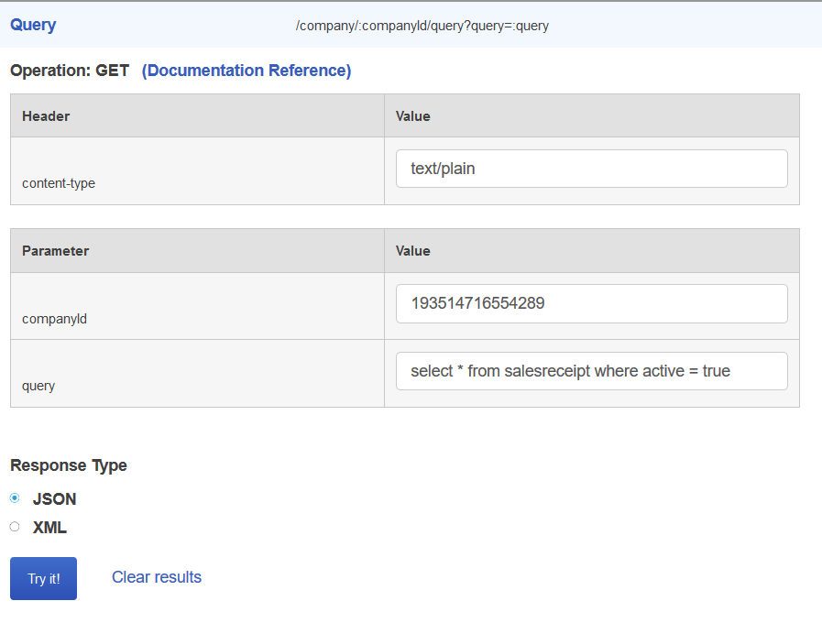
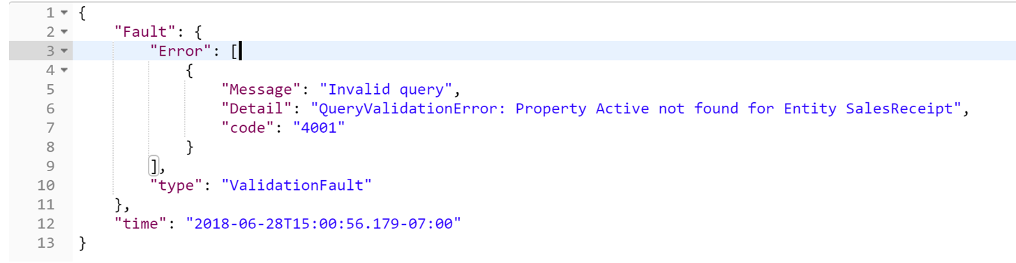
Getting 1 more Get to work
Decided to change Sales Receipts
Do ReadAll and it gives me an Invalid Query error
Thought it was something in my app, so test the Get in QB API Explorer
Got same error
Then decided to read the error message
Property Active Not found! Means the table doesn’t have a field called Active!!!

Slide 16
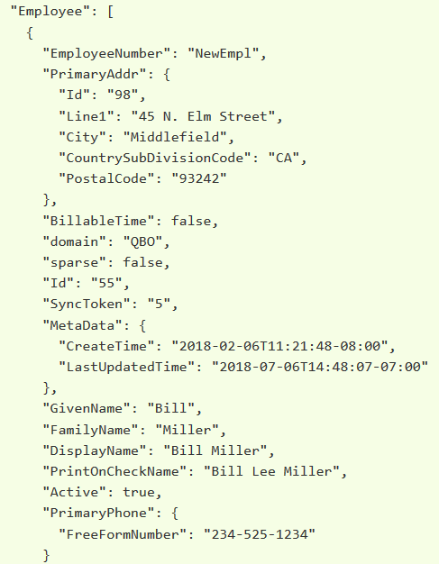
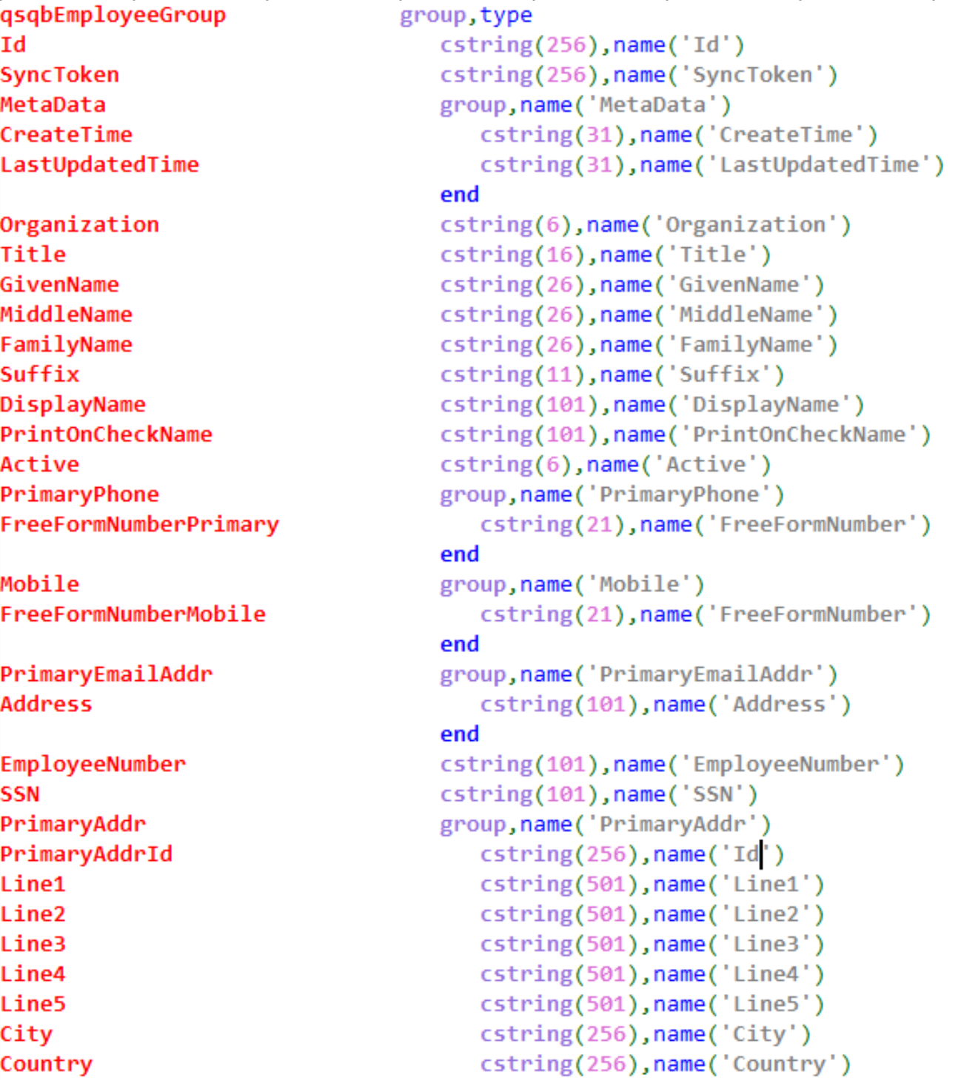
Changing from XML to JSON
Changing from xFiles to jFiles
Biggest lesson I learned here was with
JF:CaseAsIs
If you are using JF:CaseAsIs you have to use external names on all your variables and the case has to be the same as the API

Slide 17
Posting an UPDATE
Since I was no able to read records from QuickBooks the next step was to look at Updating QuickBooks
Now that I have the Get under the belt, the Post should be easy?
QB Online Mind Map – API Process - Post
So I do the Post and it doesn’t work!!
First step is check the API documentation
Open Postman
RequestToken, Login to QB, Connect to my app
Do get customer and check SyncToken
Version number of the object. It is used to lock an object for use by one app at a time. As soon as an application modifies an object, its SyncToken is incremented.
I thought that I was responsible for the update and that is what caused the issue as QB is incrementing the number itself

Slide 18
More Posting Lessons
Read the API Documentation
Certain fields are required
Fields can have specific formats. Like email address. Must have @ and .
Use the QB API Explorer because the messages are more descriptive than using Postman
For example with invalid email address json/postman just say invalid property where API explorer tells you email address doesn’t adhere to RFC specification
Don’t copy one procedure to another procedure and forget to change the query
Trying to pass this '/employee?operation=update&minorversion=4’ when it is a customer will give you errors

Slide 19
More Posting Lessons
Read the whole line in DebugView++
DebugView concatenate the line and that means you might miss some info. Copy the line to NotePad++ and read the whole line
When creating the JSON Structure it is better to create the whole structure
Created only half of the structure and that meant that the “Active” field, that was not in my structure, was set to blank and QB doesn’t allow that.
You might even get this wonderful descriptive error message:
{"Fault":{"Error":[{"Message":"Request has invalid or unsupported property","Detail":"Property Name:Can not deserialize instance of java.util.ArrayList out of START_OBJECT token\n specified is unsupported or invalid","code":"2010"}],"type":"ValidationFault"},"time":"2018-07-10T08:47:34.708-07:00"}

Slide 20
More Posting Lessons
Process to find the problem
Have trace statements in your code that output the URL and Body
Capture those statements in DebugView++
Copy to NotePad++. (Use Alt+Shift key to delete columns)
Copy the URL + Body into Postman or QB API Explorer
Execute and see if you get the same error
If error is still happening, start removing some of the elements from the Body part until the error disappear
Now read the API documentation why that field is giving you a problem
Fix your code

Slide 21
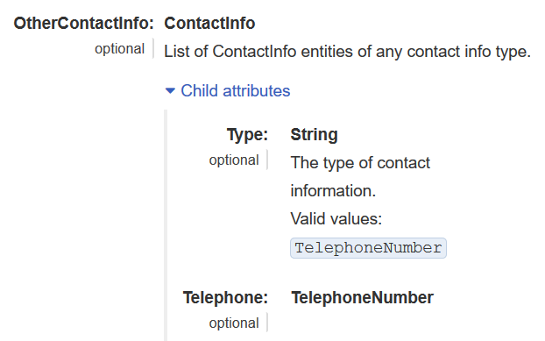
More Posting Lessons
Read the API Documentation
Remember that the API documentation might be wrong!
If you add the above to your vendor structure you will get an error when posting that in the body
Did various tests, created new vendor in the app, updated every field in the front-end, read the vendor and no OtherContactInfo
Try to add OtherContactInfo gives you an error

Slide 22
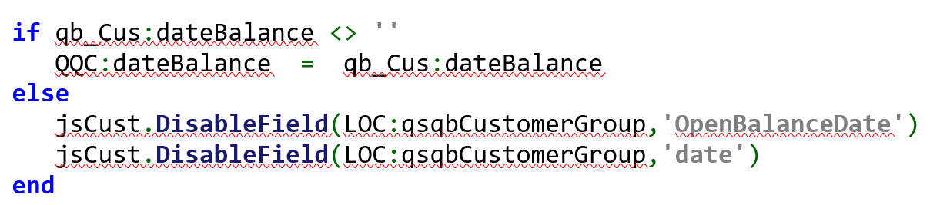
More Posting Lessons
Might have to hide fields when updating or creating entries
When doing update on customer got this error:
{"Fault":{"Error":[{"Message":"Request has invalid or unsupported property","Detail":"Property Name:Can not deserialize instance of java.lang.String out of START_OBJECT token\n specified is unsupported or invalid","code":"2010"}],"type":"ValidationFault"},"time":"2018-07-12T11:58:10.107-07:00"}
Found offending code to be:
"OpenBalanceDate": { "date": ""},
API Documentation is stating: Write-on-create
Have to hide the field

Slide 23
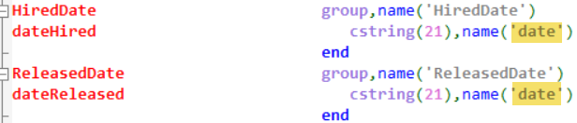
More Posting Lessons
On Insert Hide items like
jsEmpl.DisableField(LOC:qsqbEmployeeGroup,'Id’)
jsEmpl.DisableField(LOC:qsqbEmployeeGroup,'SyncToken’)
If you have duplicate labels
jsEmpl.DisableField(LOC:qsqbEmployeeGroup,'HiredDate’)
JSEmpl.SetColumnDisabled(42,true)
Fields that are read-only should be hidden on update
jsEmpl.DisableField(LOC:qsqbEmployeeGroup,'MetaData')
jsEmpl.DisableField(LOC:qsqbEmployeeGroup,'CreateTime')
jsEmpl.DisableField(LOC:qsqbEmployeeGroup,'LastUpdatedTime')

Slide 24
More Posting Lessons
Sparse
Field that specify if you are doing a full update or only certain fields.
Not implemented yet in my NetTalk App
Some Fields are not part of the API documentation but is used by the API
Domain
Populated with ‘QBO’ but no need to populate it

Slide 25
QuickBooks Online
Demo if there is time

Slide 26
nardus.swanevelder@gmail.com

